Slide 1
Lab 2

Slide 2
Time Complexity, a Review
Big O
as opposed to little o
O stands for operation

Slide 3
Upper Bound
Big O is the Upper Bound.
T(n) <= c * f(n) then T(n) is O(f(n))
For all n

Slide 4
Note
This doesn’t have to be true for all values.
It has to be true from all points after a specified value of n.

Slide 5
Lower Bound
Big Omega is the lower bound
T(n) >= c * f(n) then T(n) is O(f(n))
For all n

Slide 6
Big Theta
Between this function for c_1 and c_2
c_1 * f(n) >= T(n) >= c_2* f(n)
For all n
Just means that T(n) is both O(f(n)) and Big Theta of (f(n))

Slide 7
Question?
T(n) = ½ n^2 + 3n
T(n) = O(n) – NO
T(n) = Big Omega (n) – YES, not very good but valid
T(n) = Big Theta (n^2) -- YES
T(n) = O(n^3) --YES, not very good but valid

Slide 8
Little o
For every Constant c, T(n) <= c*f(n)
The difference being that it is all constants not just the one.

Slide 9
Moving on

Slide 10
AVL Trees
Height Balanced binary search trees
First balanced tree data structure to be invented.
Soviets: Adelson-Velsky and Landis
1962
Meaning one branch is never more than one level greater in length than the other branch coming off of that node.
Why might this be good?

Slide 11
Height balanced therefore
O(Log(n)) time
Search
Insert
delete

Slide 12
Note
Note from time complexity topic, often we as computer scientists get lazy and say O when we could say big Theta. It is still correct of course but could be more specific.

Slide 13
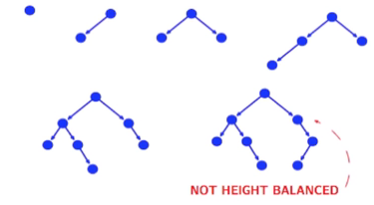
Examples

Slide 14
How do we maintain this Height balance?
What if we had a tree that started at 4, then added 3, 2, 1?
Rotations.
Who knows what rotations are?
Basically we are rearanging the tree so that the specifications of the Data structure can be met.

Slide 15
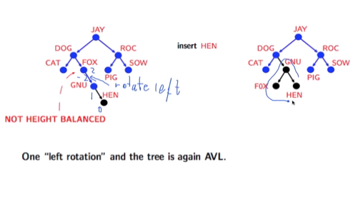
10
18
4
3
6
16
19
7
8

Slide 16
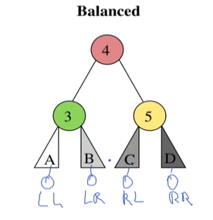
Larger rotations
How might you do these?

Slide 17
Deleting nodes?
If it is a leaf – easy, just delete
If it only has one child – easy, delete and move child up
If it has two children?

Slide 18
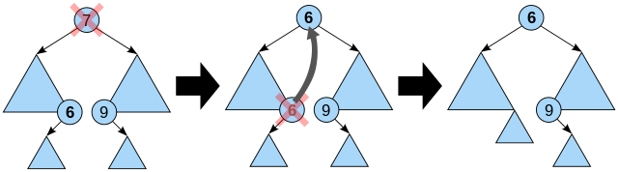
Find the closest match
In reality you can choose right or left
If left find the largest node,
If right find the smallest.

Slide 19
Try drawing an AVL tree with height 3 and the minimum number of nodes.
What about height 4?

Slide 20
HW Q1
Lecture Slides 3
Slide 18

Slide 21
HW Q2

Slide 22
HW Q3

Slide 23
HW Q4

Slide 24
HW Q5

